Slide 1
Customer Segmentation
Visualisation to understand customer behaviour and key takeaways.
Pranali Bose
April-2022

Slide 2
Problem Statement
Draw business insights and extract relevant information from the provided transactions data

Slide 3
Agenda
NOTE:
To change images on this slide, select a picture and delete it. Then click the Insert Picture icon
in the placeholder to insert your own image.
Data Understanding
Data Cleaning
Feature Extraction
Understand the Trend/Pattern
Return Orders Ratio
Dominant Country
Busiest Time of the Day
Most Popular Items
Monthly/Weekly Sales Trend
Overall Sales at a Glance
Outliers
Price
Quantity
Top 10
Customers
Invoices
Feature Correlation
Customer Segmentation: k-Means
Finding optimum k value
Grouping based on certain features
Visualizing the clusters
Conclusion
Challenges
Key Takeaways
Recommendations

Slide 4
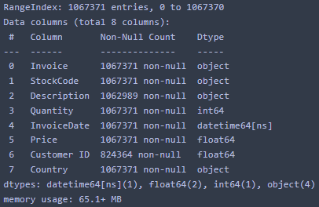
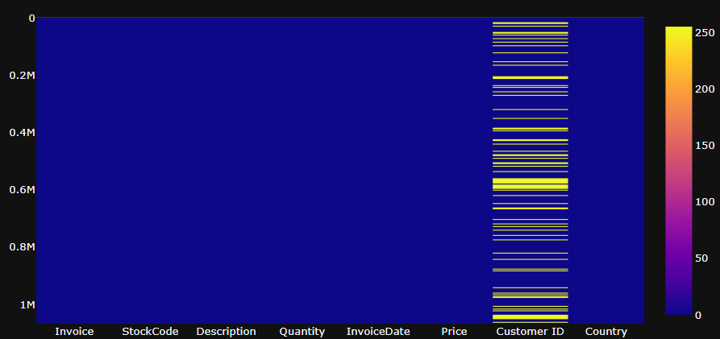
1. Understanding the Data and Data Cleaning
Features: 4 categorical and rest numerical
Missing values in Customer ID and Description
Memory usage (reduced to half)
Missing values

Slide 5
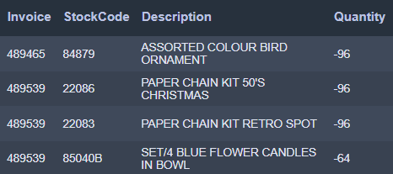
2. Data Cleaning
Dropping nan Customer IDs
Cancel Order Quantities

Slide 6
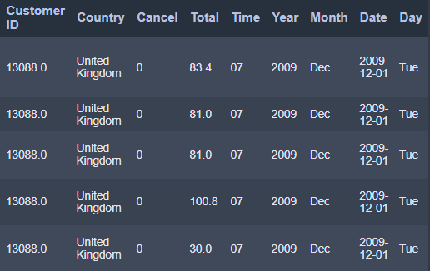
3. Feature Extraction
Cancel: Whether it is a cancel order
Total: Product of Price and Quantity
Year: Year of the purchase
Month: Month of the purchase
Date: Date of the purchase
Day: Weekday of purchase
Time: Time of purchase

Slide 7
4. Trend/Pattern
Let us now answer some key business questions via visualizations
We will only be considering UK customers as they are in majority

Slide 8
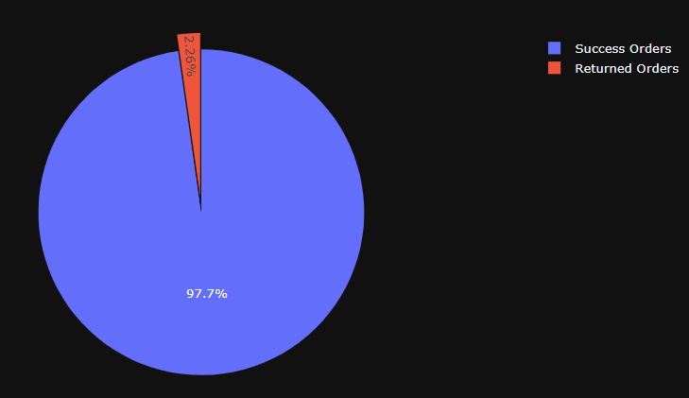
What is the Return Order Ratio?

Slide 9
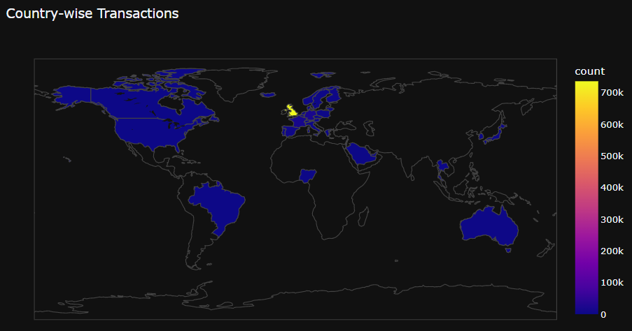
Which is the dominating country?

Slide 10
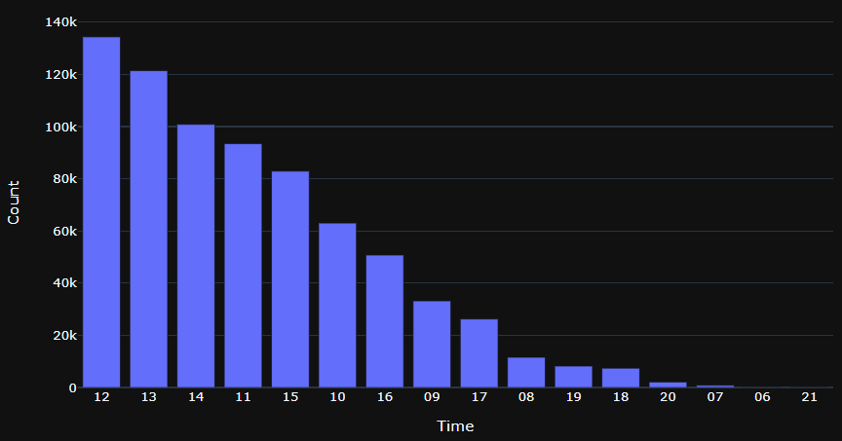
When are customers most likely to purchase?

Slide 11
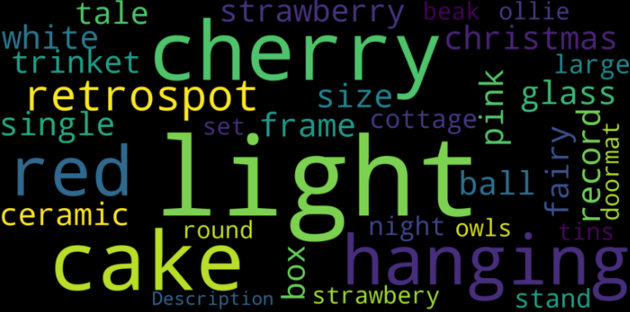
Identify the popular keywords

Slide 12
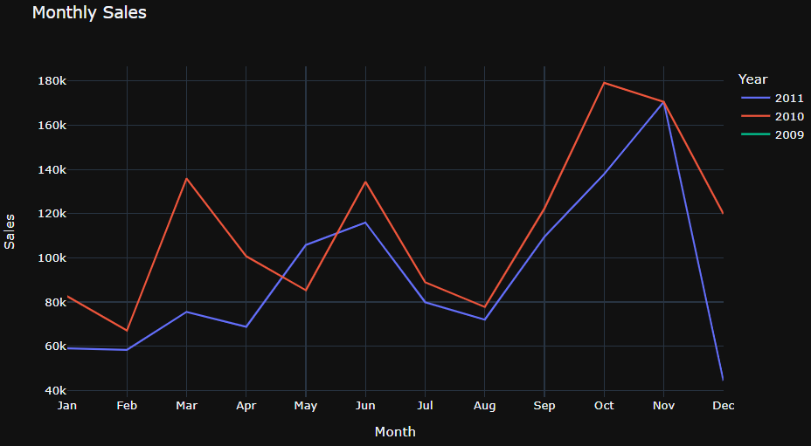
Display monthly sales

Slide 13
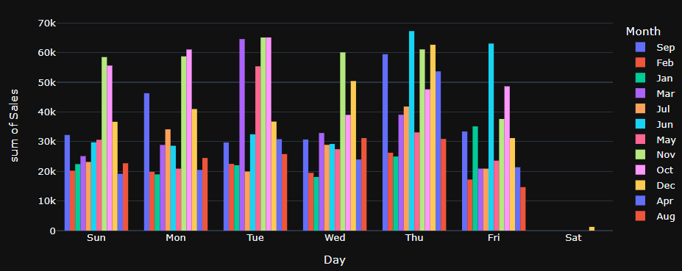
Are sales more on weekends?

Slide 14
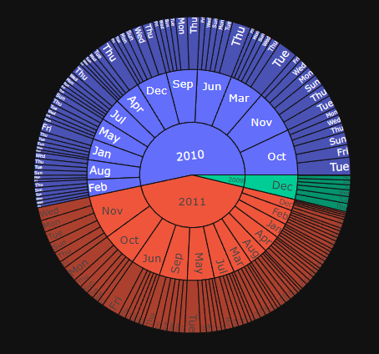
Sales vs Time at a glance
This interactive sunburst summarizes the sales
over the time period.
Clearly 2010 incurred the maximum sales. Only
December data is provided for 2009.
Also, among all days, Tuesdays, Thursdays and Fridays
made the most sales

Slide 15
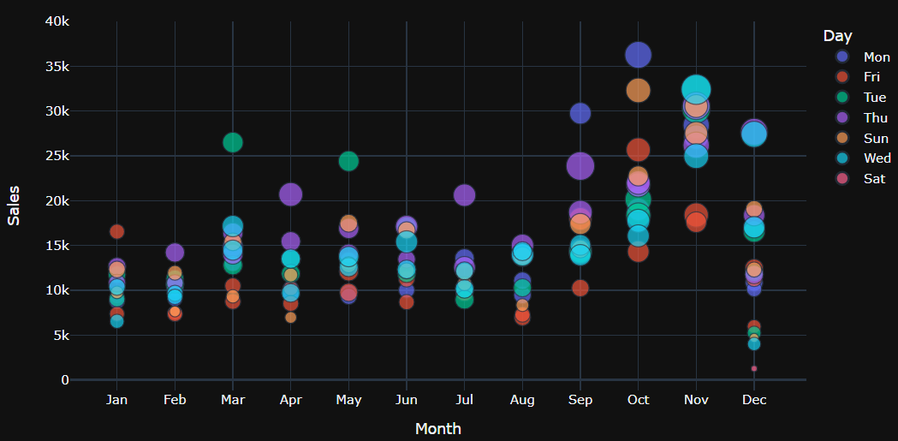
Visualize day-wise monthly sales

Slide 16
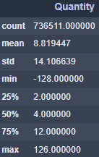
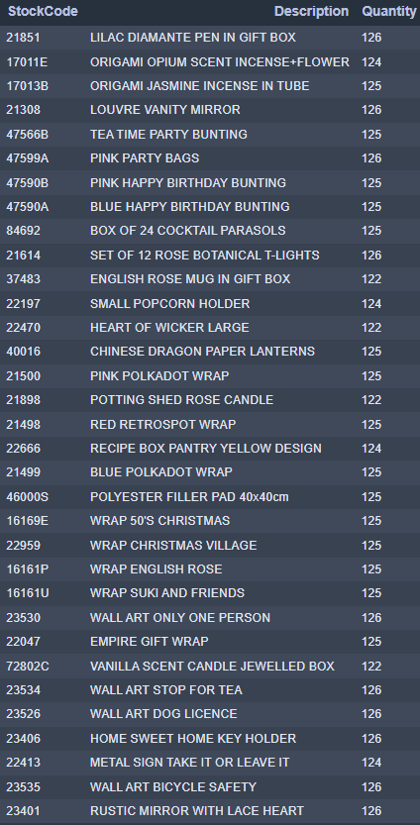
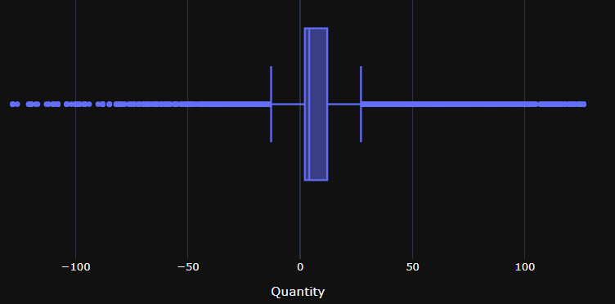
5. Outliers - Quantity
Stats
Items purchased in bulk

Slide 17

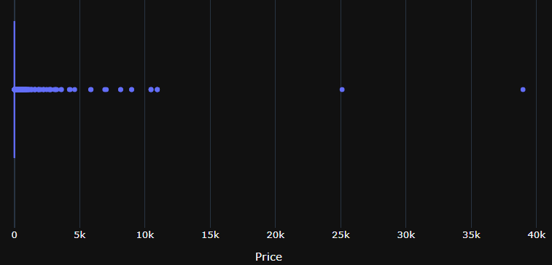
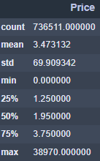
5. Outliers - Price
High-priced Items
Stats

Slide 18
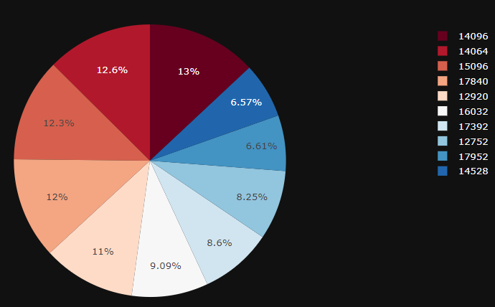
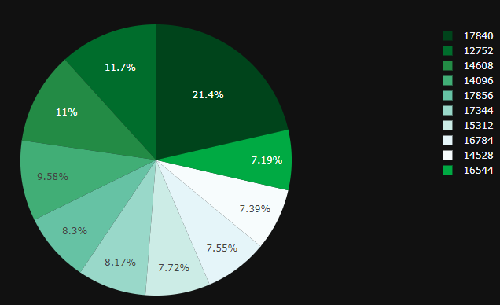
6. Top 10 - Customers
High-valued customers
Most frequent buyers

Slide 19
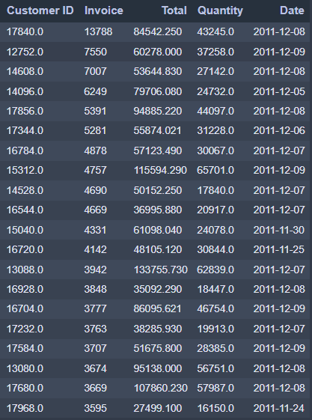
Details of Top Customers
Invoice: Total number of purchases
Total: Total amount spent since the first purchase
Quantity: Number of items bought
Date: Most recent transaction of the customer

Slide 20
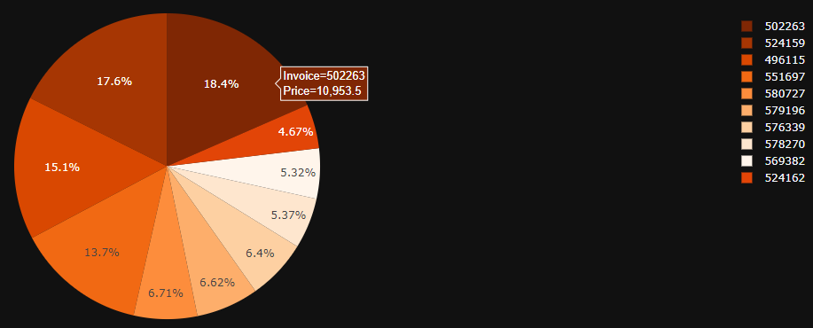
Top 10 - Invoices
Costliest Invoices

Slide 21
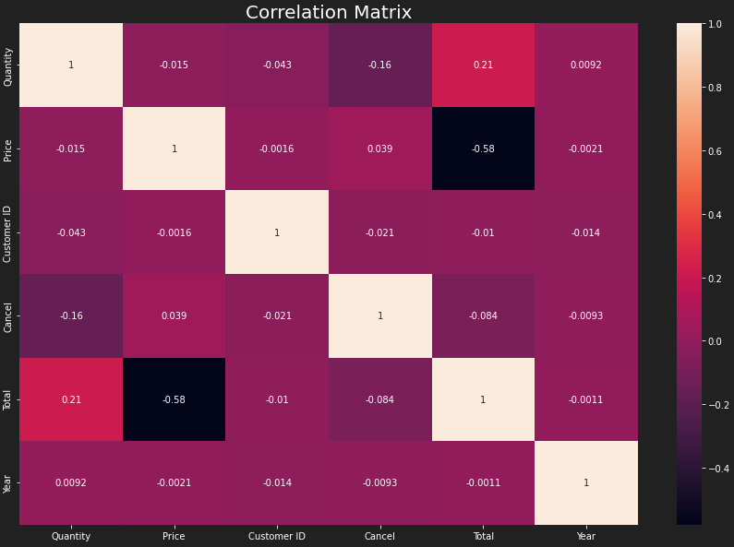
7. Feature Correlation
Price and Total are highly negatively correlated
Total is positively correlated with Quantity
Cancel and Quantity are negatively correlated
Rest of the features are negligibly correlated with each other

Slide 22
8. Customer Segmentation

Slide 23
Data Preprocessing
Feature Selection
Encoding
Data Cleaning
Feature Scaling
k-means algorithm is sensitive to outliers as it calculated the distance between the centroids and the other data points. Therefore, it is mandatory to carefully handle the outliers. As it is a distance based algorithm, feature scaling is another important preprocessing step.

Slide 24
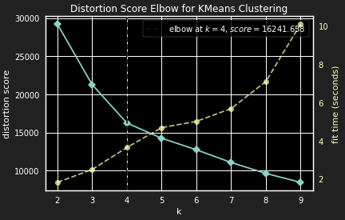
Selecting k value
In k-means clustering it is important to select the right number of clusters. To help us select the optimal
number of clusters we will use the elbow method.
For each and every cluster number the Within Cluster
Sum of Squares is calculated and plotted in a graph.
The graph forms a shape of an elbow, meaning,
after a certain number of clusters the WCSS value
decreases marginally.
The cluster number at the elbow point is considered
to be the optimal selection.
Though, it is recommended to try one or two other
values near to the elbow value and visualize the clusters.

Slide 25
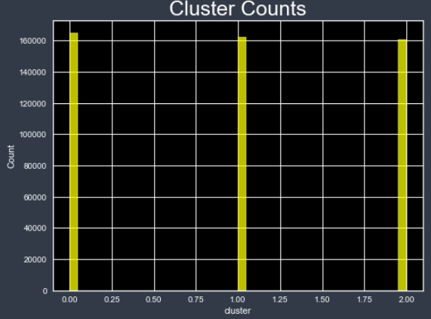
Cluster Count
We see almost equal distribution of customers in all the 3 groups

Slide 26
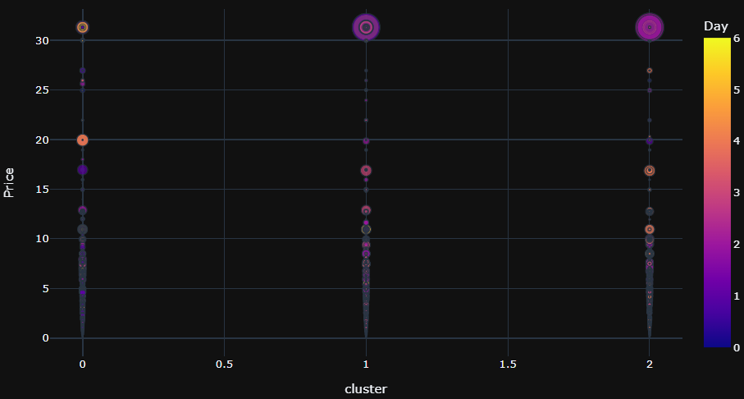
Customer Behavior

Slide 27
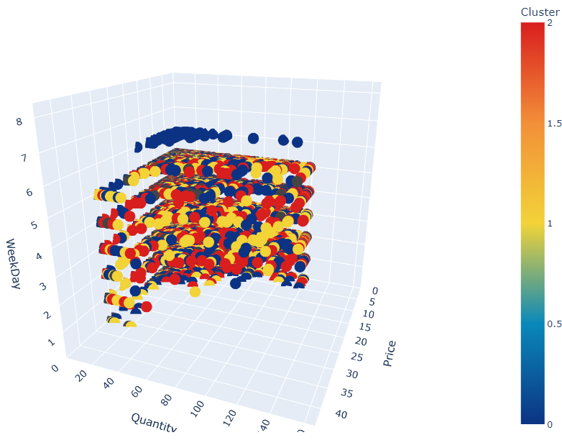
3D Visualization of the clusters
From the 3D visualization of the clusters,
we can say that the clusters are not very clearly
separable except for the blue group (group 0).
Group 0 customers tend to purchase mostly on
weekends. Also, they are likely to purchase
items in bulk.

Slide 28
9. Conclusion

Slide 29
Challenges
Large Data (Memory and Time)
Messy Data (Missing and Incorrect values)
Exceptions in Price and Quantity

Slide 30
Key Takeaways
UK is the dominant country
Afternoon is the peak purchase time
Store timing: 7AM to 8PM
Perhaps the shop remains closed on Saturdays
Return rate is around 2%
Every year December sees a drastic dip in sales
Cherry, Light and Cake are the most popular keywords
2 of the Manual items are abnormally high-priced

Slide 31
Key Takeaways (…cont)
14096 and 14064 are the most valuable customers
17840 and 12752 are the most frequent buyers
502263 is the highest valued invoice with purchase value of £10953.5
Price and Total are inversely proportional, because for high priced items the quantity purchased is less.
Customers are more likely to splurge in beginning of the week
Very few customers have spent more than 2k

Slide 32
Recommendations
The store should run its weekly discounts on Mondays or Tuesdays
It should try to identify the reason behind low sales in Decembers
It can perhaps provide some privilege membership to its top customers
Keep an eye on restocking the items bought in bulk

Slide 33
Next Steps
Use Silhouette score to verify k value
Trying other clustering algorithms like hierarchal clustering or DBSCAN
Use PCA and compare results

Slide 34
Thank You!

